Slide 1
Changing the world with Data. (Combatting Human Trafficking, As An Example)
By Eric Schles

Slide 2
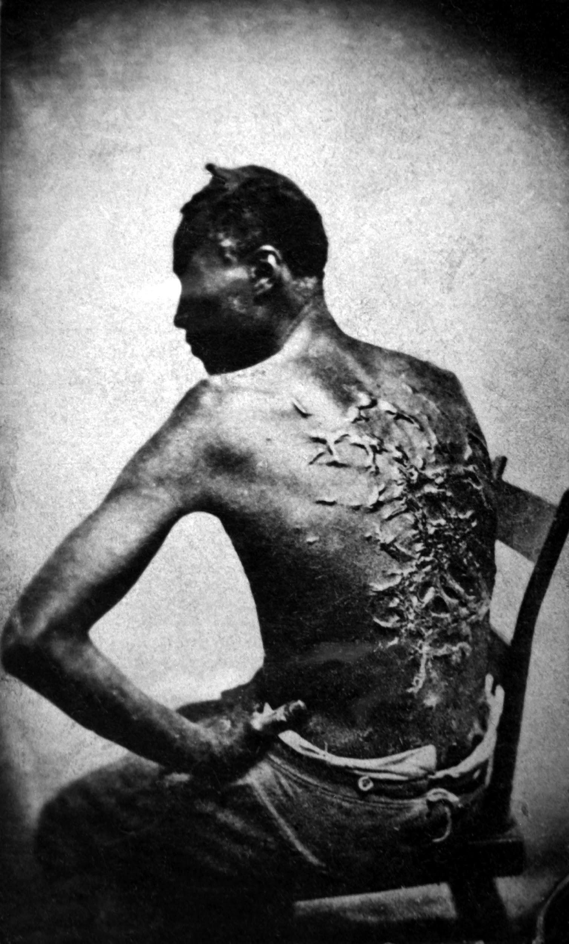
It starts with a feeling
Decide on an issue you feel you have to work on,
for me this was ending slavery.
Notes:
It starts with something you deeply care about. I saw slavery first hand when I was 11. I was on a family vacation with my parents in Southern India at the time. And I saw a man in the middle of street. He had a metal collar around his neck and his back and been broken. He was forced to beg by his owners for food. Later I came to learn that the people most likely responsible for this were his own parents. I was then that I decided I need to do something about this.

Slide 3
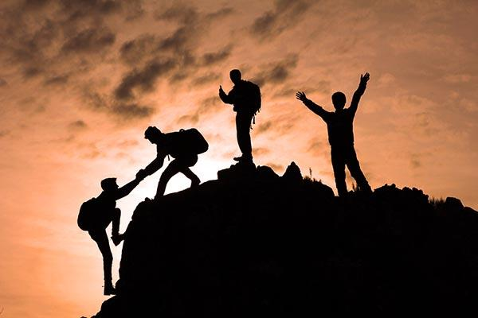
Finding your people
You can’t solve anything on your own.
You need a group of people with you.
We have power in numbers and to keep
The work from burning any one person out.
Notes:
Find like minded individuals, locally at first and then else where. I spent 10 years on my own trying to do this work. During that time I learned a lot about the problem space and the work of others. I researched and studied everything I could get my hands on. But all of that work and research wasn’t very useful to anyone but me. It wasn’t until I started collaborating with others that I had an impact. Hearing what others were doing in the space by finding others that cared about my issue, ultimately lead me to have a huge impact. It’s not about what you know at first, it’s about showing up. Being informed and doing your homework ahead of time matters. But social issues are hard and very dynamic. The problems a given community had 5 years ago might not be the same as today and might require different solutions.

Slide 4
Build a thing
Demo (craigslist scraper)
&&
Results
Notes:
This is the first thing I built. It was a simple scraper that would pull information from craigslist.
http://www.huffingtonpost.com/eric-schles/how-to-hack-against-slave_b_4518930.html
https://github.com/EricSchles/csvconf_talk/tree/master/scraping_craigslist

Slide 5
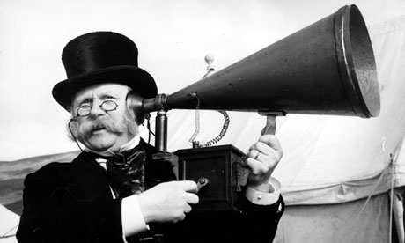
Find people effected by the issue you care about
Get their feedback and iterate
on your system with them in mind.
Notes:
The first system I built “worked” in the sense that it did what it was supposed to and got me to publish an article in the huffington post. But past that, the tool was useless. It solved a problem that didn’t really exist - something I wouldn’t have been able to find out without having worked for the people who actually solve these crimes. It is very easy to tell what ads are trafficking and what ads are not. It turns out that this is an easy thing to do investigatively when you have the power of subpoena. Also, the cops have set up a series of systems to flag certain cases. This is standard practice for most police departments, so by the time it gets to investigators, you usually don’t need to generate any leads. To the contrary usually you have the leads. It’s about processing them quickly.

Slide 6

Take your thing on the road
Once I iterated I actually was able to
Build a system that helped people
DEMO
(Investigator)
Notes:
Once I iterated and built a system that was useful, I was able to go across the country, developing my network and refining the system. I also would give any findings I had to others. Usually for free.

Slide 7
Stay connected with those across the country
Once you build a system that really works
It’s easy to make more
DEMO
(Document Search)
Notes:
After I built my first successful system I was able to build even more systems that helped people

Slide 8
See the change in the world
Eventually, with enough effort you will get results, but it takes long term effort.
With the combined efforts of many people across the country, the cause to end slavery has:
Been able to put the CEO of backpage behind bars, sending a strong signal that trafficking has costs
Been able to lift some victims out of slavery and find a better life

Slide 9
Some resources
https://www.fightforthefuture.org/ateams/
--start your own idea and get it funded!
https://tech-forward-2.glitch.me/
---volunteer your time with one of these wonderful orgs
https://lists.44.digital/
--or one of these wonderful orgs
https://flipboard.com/@flipboard/-nonprofits-not-silicon-valley-startups-/f-cde264c75a%2Frecode.net
--AI non-profits

